Slide 1
News from Olympia
Arlene Crum
Director of Mathematics
Office of Superintendent of Public Instruction

Slide 2


2016
2019

Slide 3
Stand and Talk
Walk at least 10 steps to find a partner and take ONE paper for your pair.
Partner #1
(Closest to the food)
What do you notice?
Statements about what you see
Partner #2
What do you wonder?
Questions about what you see or what your partner saw
Together
What is a title for this graph?

Slide 4
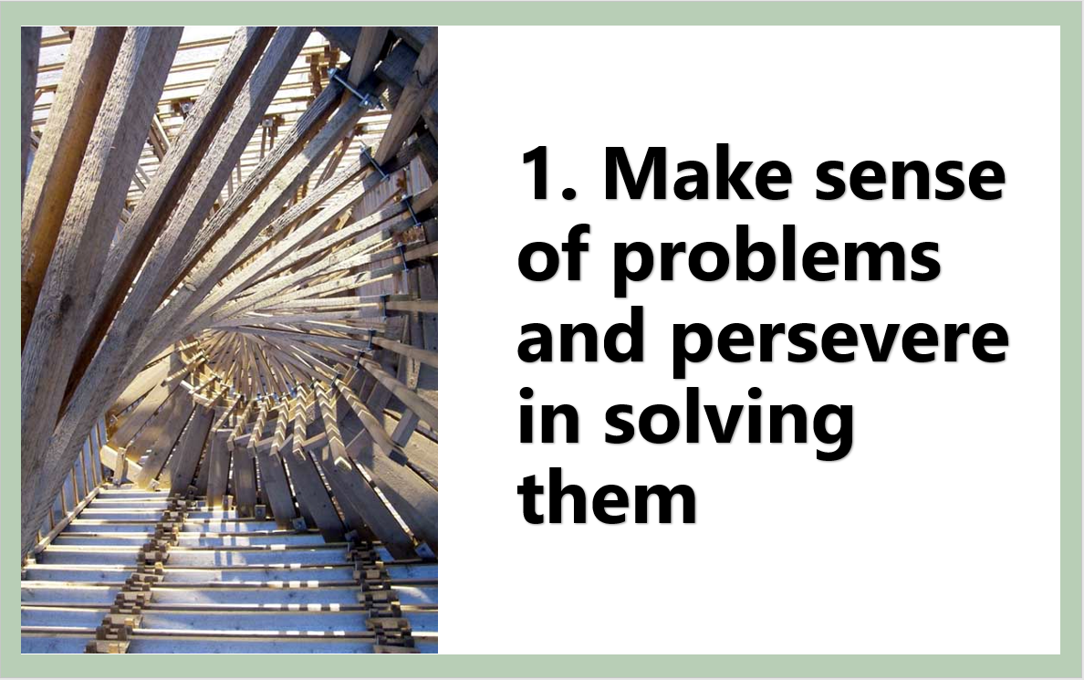
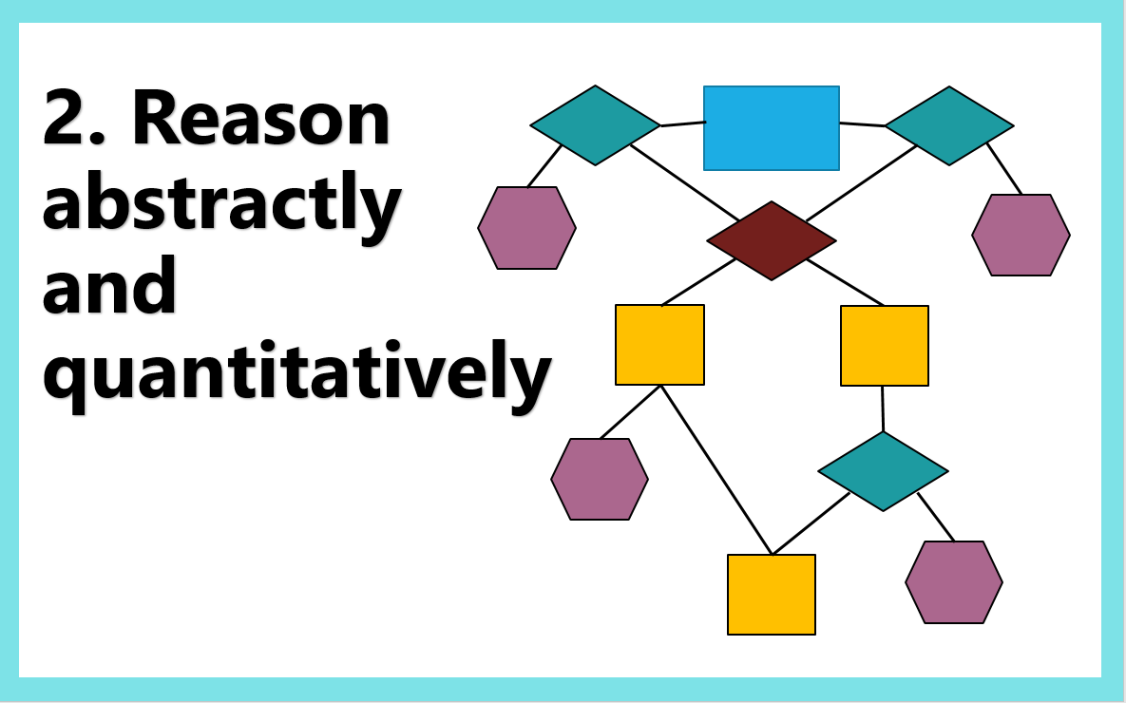
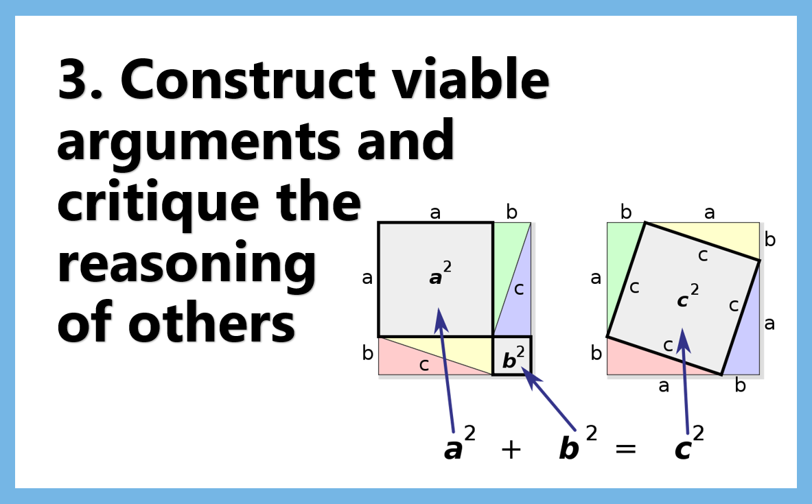
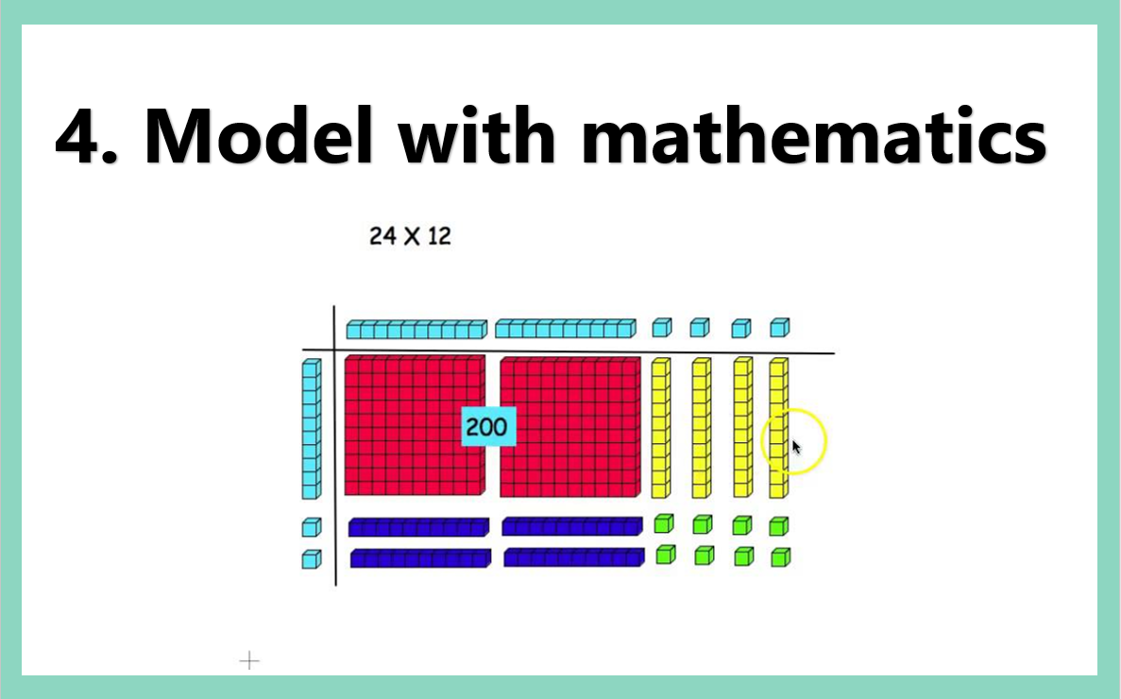
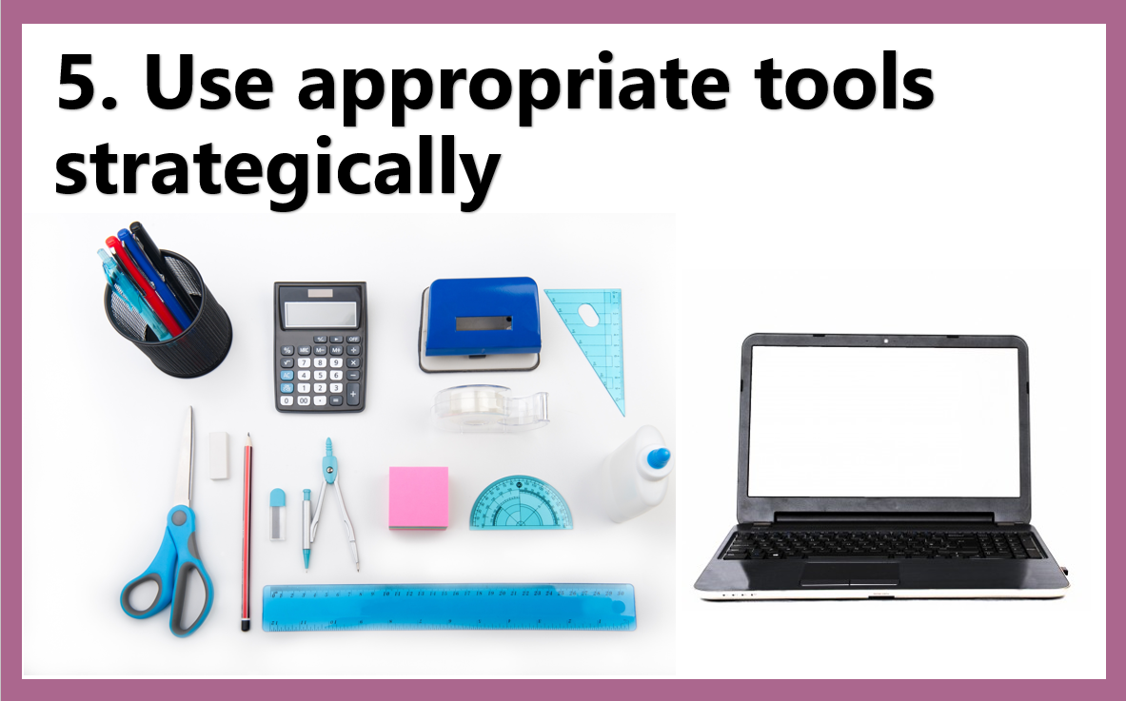

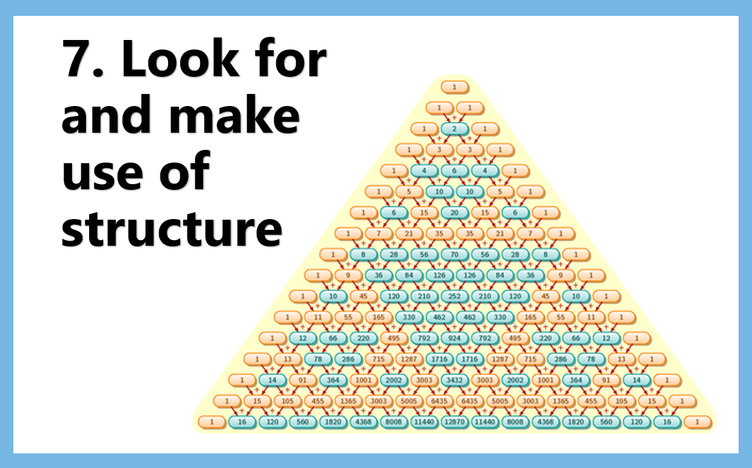
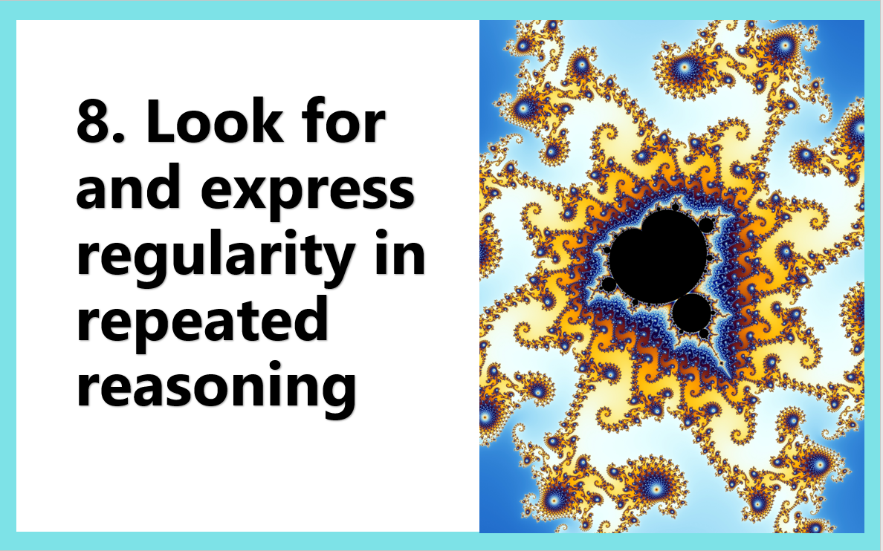
Standards for Mathematical Practice

Slide 5
Notice & Wonder
I noticed that… I wonder…

Slide 6
Notice & Wonder
Number Talks
Clothesline
Ten Minute Talks
My Favorite KNOW
Which One Doesn’t Belong?
Mathematically Productive
Instructional Routines
MPIRs
Learning-space.org
Effective Instruction
Mathematics
https://www.learning-space.org/Page/58

Slide 7


Modeling Our World With Mathematics

Slide 8
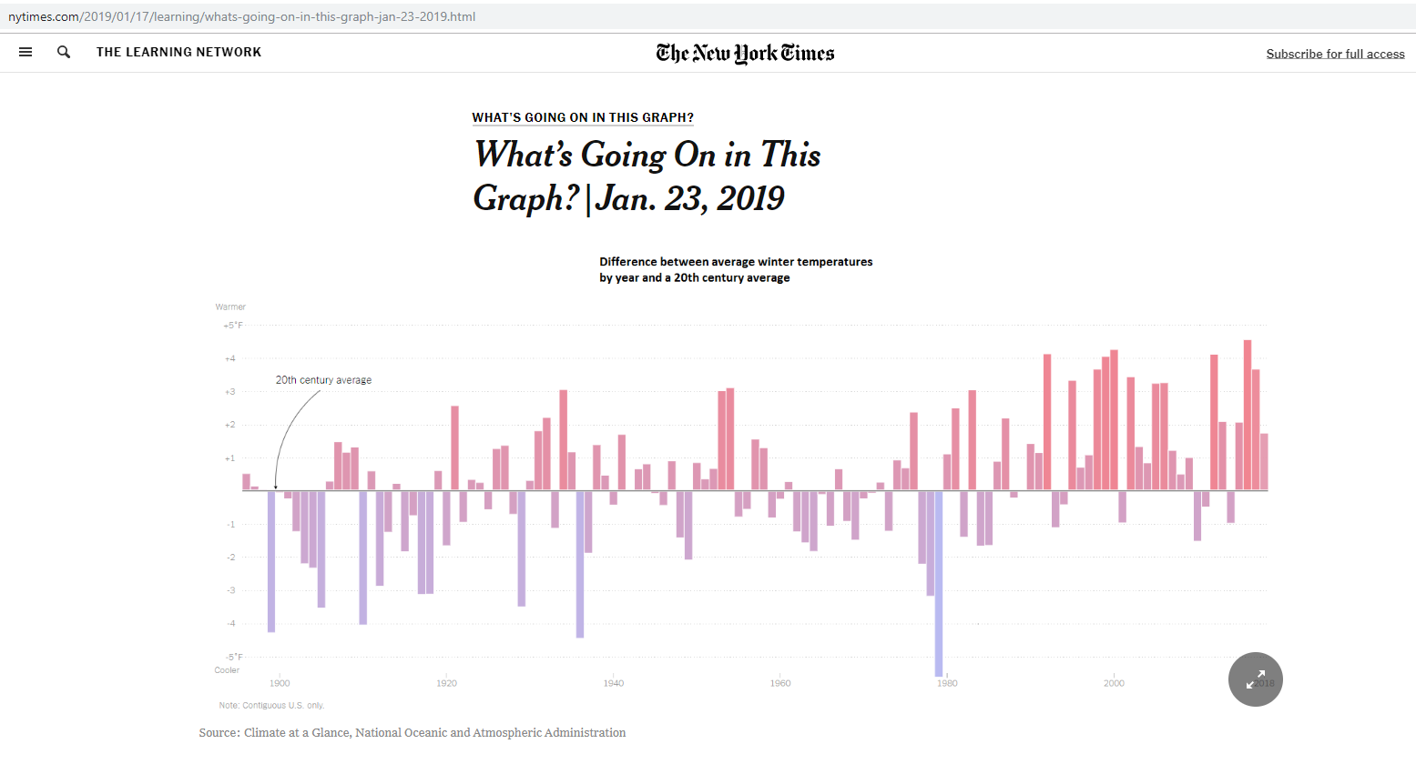

Slide 9
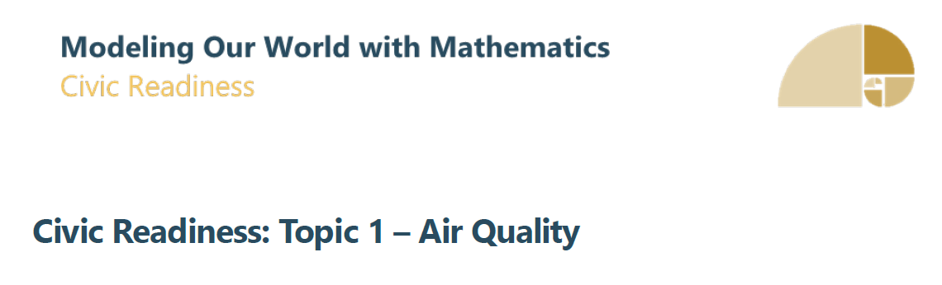
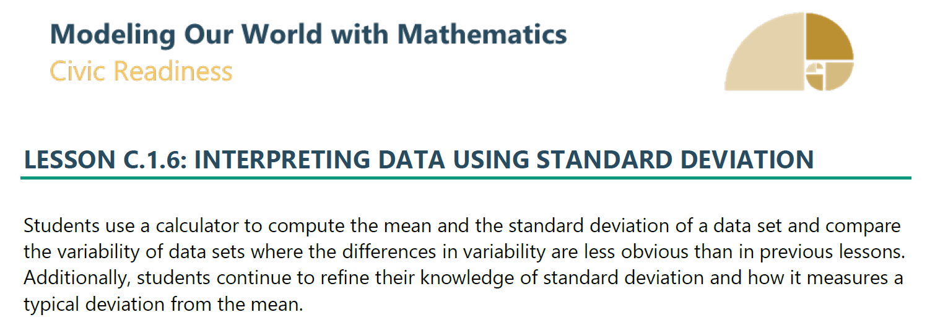

Slide 10


Activity 2: Interpreting the Standard Deviation
Have students complete one of the following lessons about Standard Deviation.
Interpreting the Standard Deviation Algebra I Module 2 Topic B Lesson 6 © Engage NY. All Rights Reserved.
Standard Deviation | © Kendall Hunt. All Rights Reserved.
Activity 3: Finding Standard Deviation
Students need to:
  Determine the standard deviation for the AQI and temperature for their given city.
  Describe how this information might be useful to assist in the understanding of the data
Summary/Closure
  Use the Lesson Summery/Exit Ticket/Cool-down included in the lesson used.
Launch
Project the following image. Follow What’s Going on in this Graph? protocol:
Lesson
Activity 1: Calculating the Standard Deviation
Standard Deviation (PPT)
Created by OSPI. Creative Commons Attribution 4.0 International
Teacher note: The purpose of the PowerPoint is to provide understanding of where Standard Deviation comes from and to appreciate the power of having a tool to find it.

Slide 11
Dual Credit
College in HS
Running Start
CTE
AP, IB or Cambridge
C+
Pass Exam
Combination
G r a d u a t i o n P a t h w a y s
SBA
Math 2595
ELA 2548
Transition Course
Bridge to College
SAT/ACT
Math 430/16
ELA 410/14
CTE Sequence
Core Plus
2-credit sequence
ASVAB
31
http://sbe.wa.gov/our-work/graduation-requirements/graduation-pathway-options

Slide 12
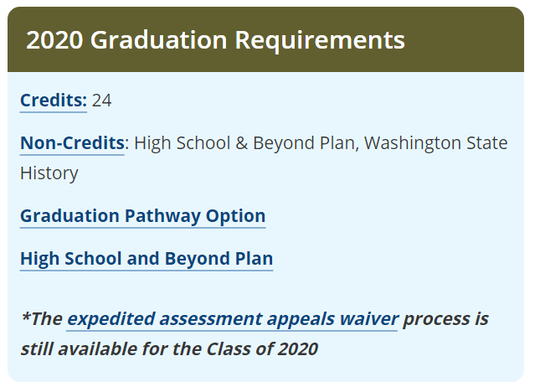
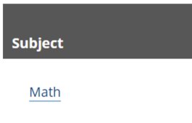
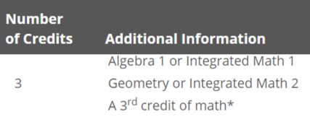
The Class of 2020
*The 3rd credit of math is chosen by the student based on the student’s interest and High School and Beyond Plan, and approved by the parent or guardian. (WAC 180-16-200)
http://sbe.wa.gov/our-work/graduation-requirements/graduation-requirements-class-2020
https://www.k12.wa.us/student-success/graduation/graduation-alternatives/expedited-assessment-appeals-waiver

Slide 13

Arlene Crum
Director of Mathematics
Office of Superintendent of Public Instruction
Arlene.Crum@k12.wa.us

